Slide 1
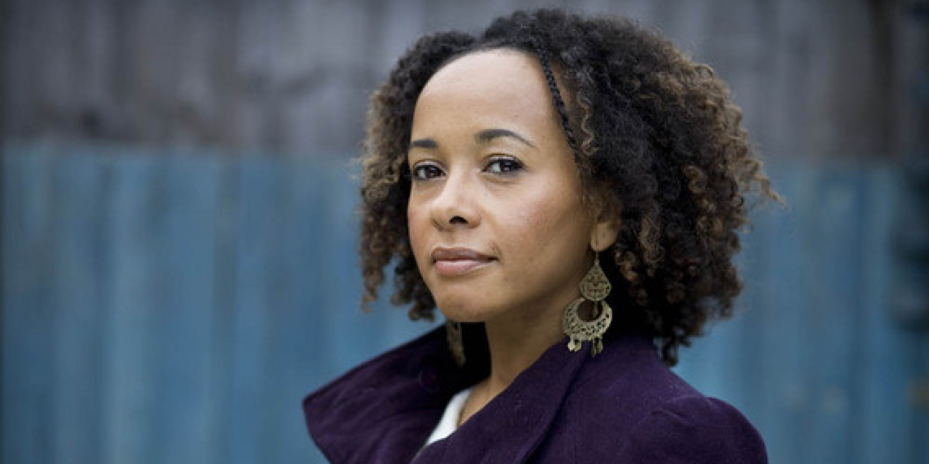
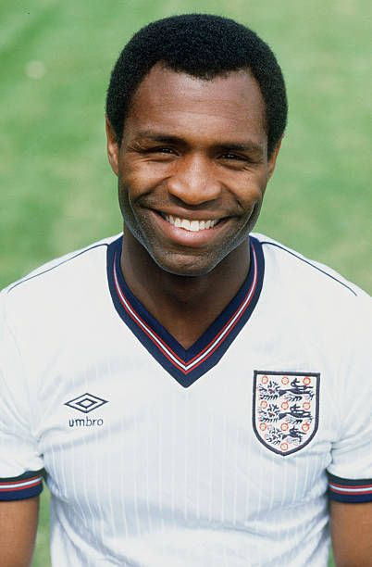
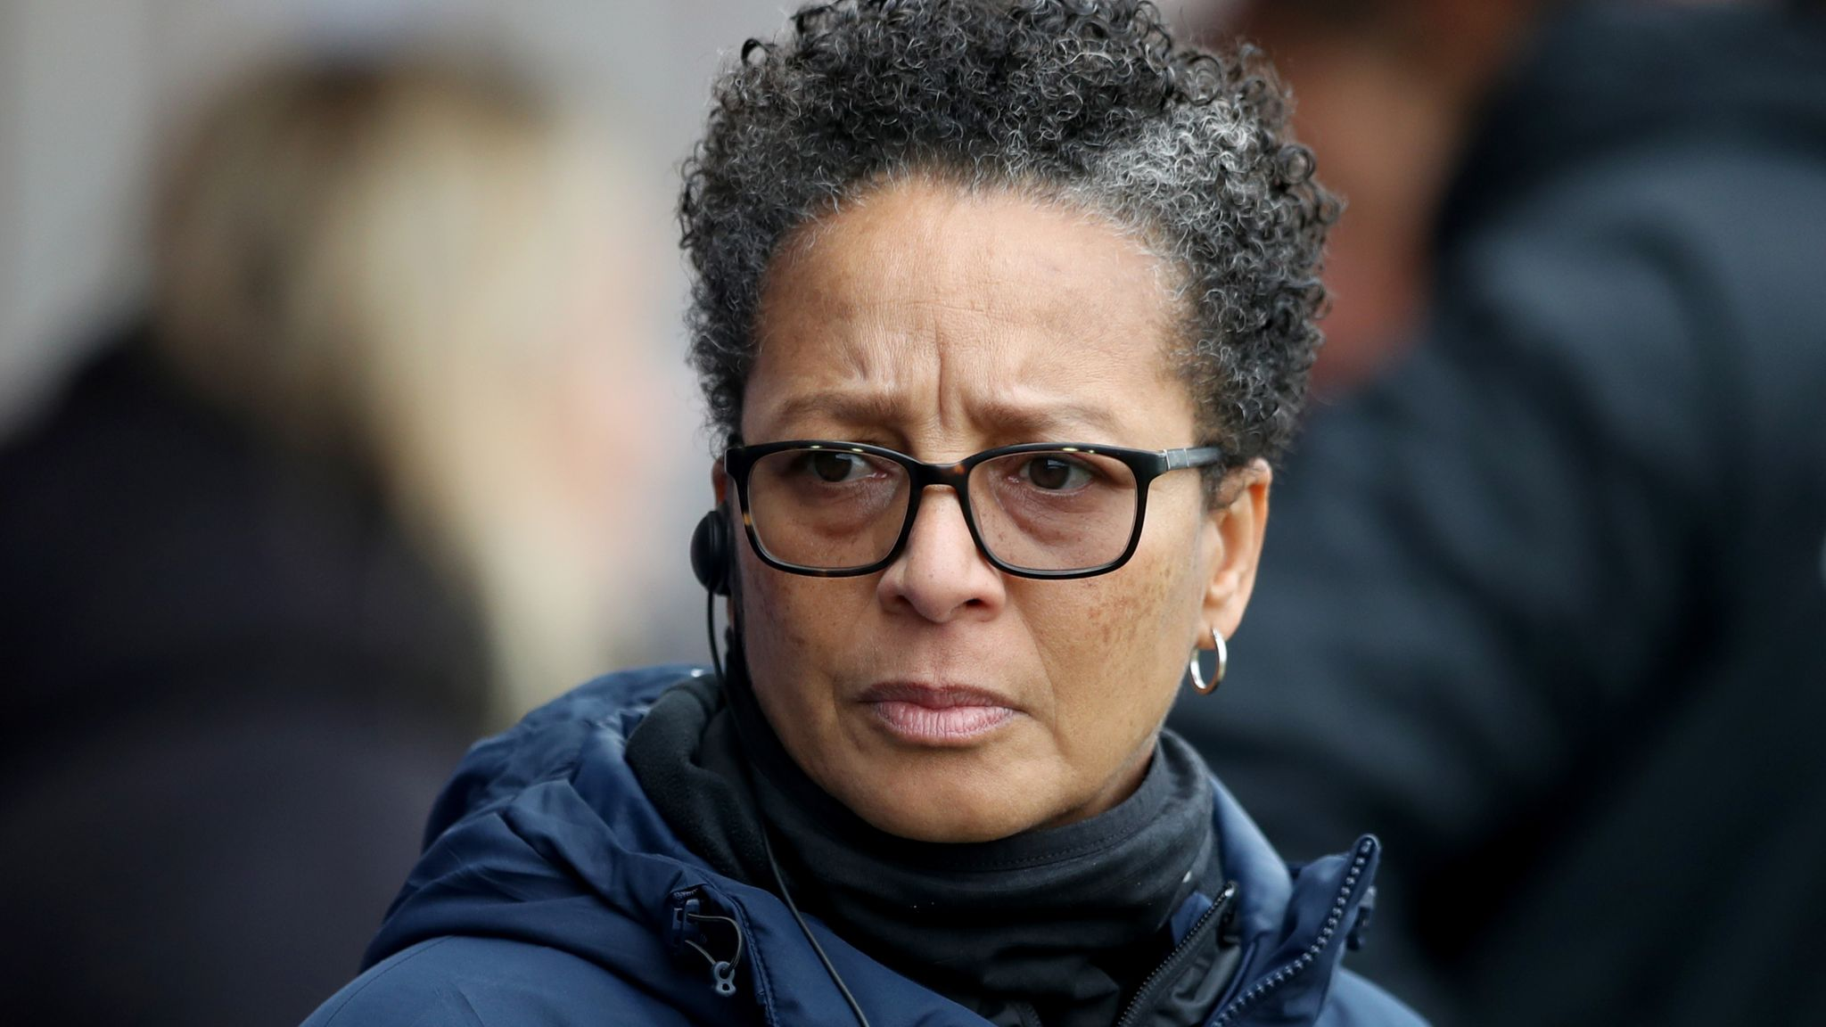
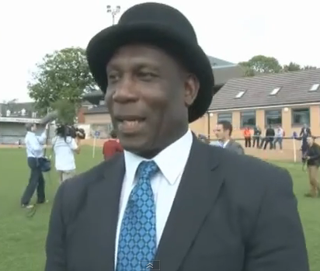
Teaching African and Black History is crucial in fostering a deeper understanding of the world's diverse cultures and histories, promoting empathy and respect. It provides a balanced view, dispels stereotypes, and nurtures a more inclusive, harmonious society.
Teachers play a pivotal role in fostering positive racial identity development in children. This is not merely about conveying facts and dates through History lessons they deliver; it is about connecting children with their roots and origins. Understanding one's heritage is a critical component of personal identity, and education becomes the vehicle for nurturing this understanding and reclaiming narratives.
In a globalised world, understanding one’s identity and appreciating the diverse cultures that shape our society is pivotal to promoting respect, inclusivity and racial harmony.
The intended goal of these lesson plans is to empower students to reclaim narratives and promote global citizenship as they explore the concepts of cultural identity, cultural diversity, open mindedness and racial harmony.
Suggested Teaching Strategies:
Begin by introducing the theme of this year’s Black History Month to the students: ‘Reclaiming Narratives’.
Session 1 (Slides 2 &3): Work through the activities with the students: Celebrating being Black British …
Share the learning objective and success criteria with students. Link the sessions to other curriculum areas (cross-curricular links) and encourage active participation in an atmosphere of mutual respect.
Learning Outcomes: At the end of these sessions, learners will …
Gain in-depth understanding of the concept of ‘Identity’ and the importance of ‘Black History’ in reclaiming narratives
Identify and locate African countries on maps and discuss the cultural diversity within the continent
Explore themes related to ‘Identity’ through African Literature, Sports, Art and Music
Create an art project that represents their understanding of ‘Black History Month’, African Identity and the importance of reclaiming narratives
Develop critical thinking skills and cultural awareness.

Slide 2

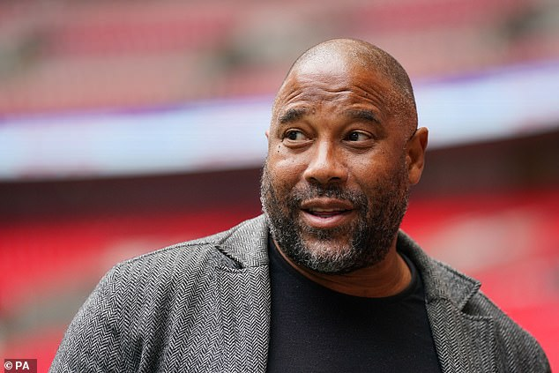
Session 1
Learning objective:
● Celebrating Being Black and British
Do Now:
What is ‘Black History Month’ and why do we set aside one month in the year to celebrate it?
Challenge:
Can you trace the History of Black people in Britain? How did generations of Black people come to live in Britian? (Class discussion)
Mega challenge:
In your opinion, do we, as a nation, celebrate the achievements of Black Brits enough? If ‘yes’, how? If ‘no’, what could we do more? (Class discussion)
As you watch Clip 1, in your opinion, what does it mean to be ‘Black’ and ‘British’?
Success Criteria:
● Describe the contributions of Black people to modern day Britain.
● Describe some key events in Black British history.
Hope Powell
Uriah Rennie
Keywords:
Black History / Reclaiming Narratives
Afua Hirsch
Luther Blissett
Cross-Curricular links:
History / Geography / PSHE / Art / PE / Music
Clip 1: Sky News: Black British And Belonging
https://www.youtube.com/watch?v=cExXMDoIk70&t=1s
Diana Evans
John Barnes

Slide 3

Session 1
Learning objective:
● Celebrating Being Black and British
Activity 2: Think. Pair. Share! (10 mins)
Now that you have watched Clip 1, what, in your opinion, does it mean to be ‘Black’ and ‘British’?
Write down at least five facts about ‘Black British History’ as you listen to the song (clip 2).
Be prepared to share your answer with the class.
Success Criteria:
● Describe the contributions of Black people to modern day Britain.
● Describe some key events in Black British history.
Hope Powell
Uriah Rennie
Clip 2: Black British History: CBBC https://www.youtube.com/watch?v=6M-qsVS8zeU&t=1s
Keywords:
Black History / Reclaiming Narratives
Plenary: Challenge!
Research an influential Black British person. Create ‘a fact sheet’ about them and their contribution(s) to the British society. Remember to mention why you have chosen that particular person!
Be prepared to share your findings with the class.
Diana Evans
Cross-Curricular links:
History / Geography / PSHE / Art / PE / Music
Reflection: In pairs, discuss with a partner …
What you have learnt about Black History Month from today’s lesson that you did not know previously.

Slide 4
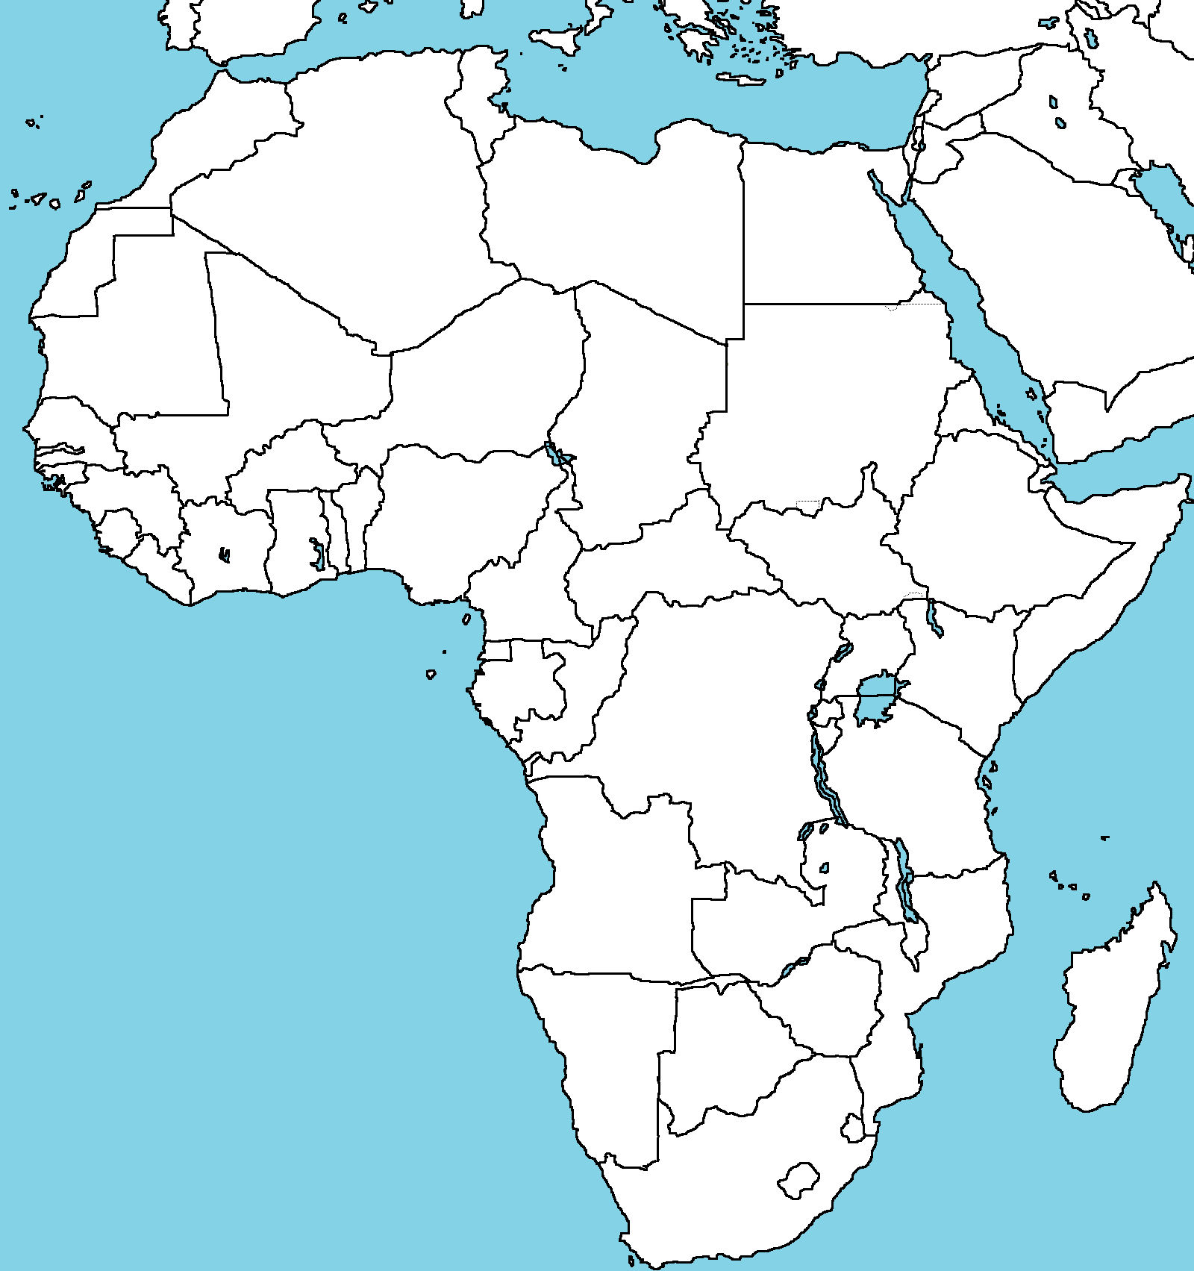
Teaching African and Black History is crucial in fostering a deeper understanding of the world's diverse cultures and histories, promoting empathy and respect. It provides a balanced view, dispels stereotypes, and nurtures a more inclusive, harmonious society.
Teachers play a pivotal role in fostering positive racial identity development in children. This is not merely about conveying facts and dates through History lessons they deliver; it is about connecting children with their roots and origins. Understanding one's heritage is a critical component of personal identity, and education becomes the vehicle for nurturing this understanding and reclaiming narratives.
In a globalised world, understanding one’s identity and appreciating the diverse cultures that shape our society is pivotal to promoting respect, inclusivity and racial harmony.
The intended goal of these lesson plans is to empower students to reclaim narratives and promote global citizenship as they explore the concepts of cultural identity, cultural diversity, open mindedness and racial harmony.
Suggested Teaching Strategies:
Introduction:
Begin by discussing the concept of identity with students. Ask students what they think defines a person's identity (Do Now task – Slide 5).
Show the first video clip (Interesting Facts About Africa), that provides an overview of Africa, highlighting its cultural richness and diversity.
Allow students to attempt the ‘Mega Challenge’ as they watch clips 1, 2 and 3. Draw connections with Geography / History and/or Art lessons, where possible.
Activity 2: Writing Task
Students write a short poem or artwork about African identity and Cultural Diversity, incorporating elements they learned from the video clips. Encourage creativity and self-expression in their poems.
Presentation and Reflection
Invite students to share their work with the class.
Encourage a brief discussion after each presentation (WWW? / EBI?).
Reclaiming Narratives: African Identity

Slide 5

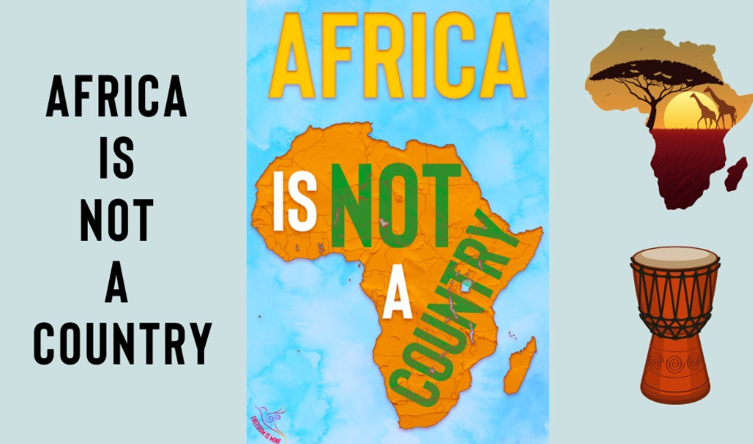
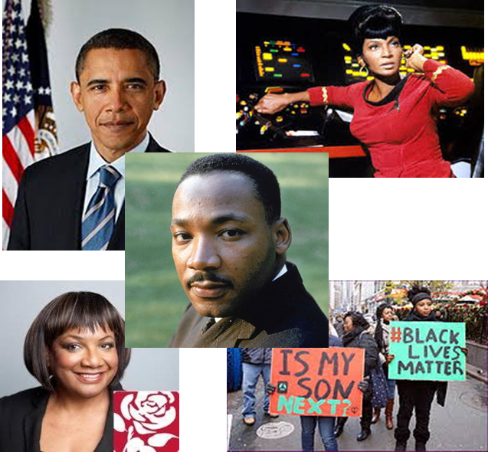
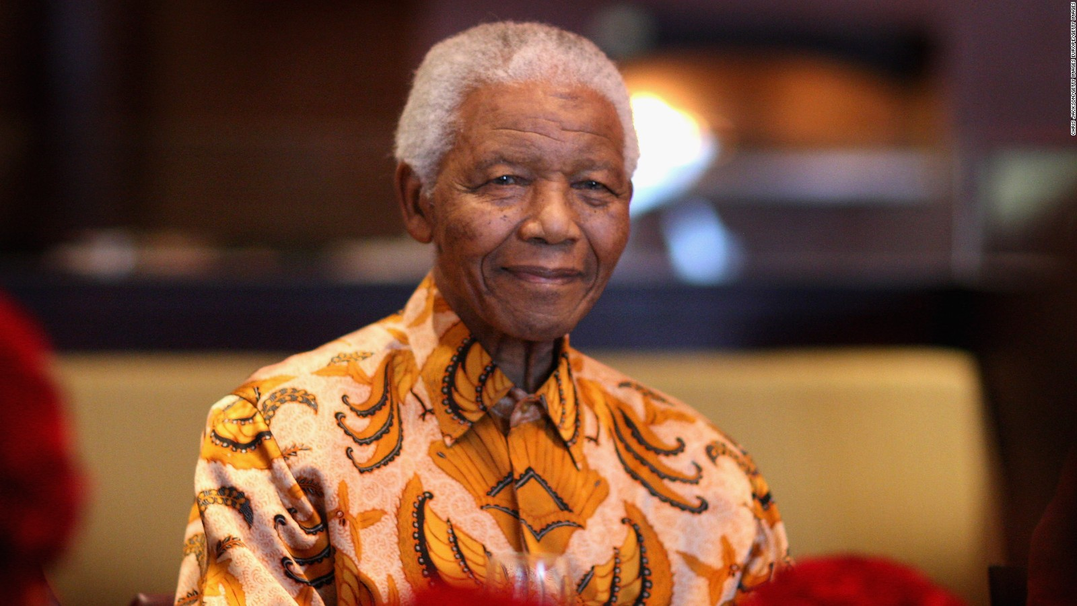
Do Now:
What do you understand by the term ‘identity’ and why is it important?
Challenge:
Is ‘Africa’ a continent or a country? How do you know?
More challenging:
What do you understand by ‘African Identity’? Why is that important?
Mega challenge:
Write down at least five facts about Africa as you watch clip 1. Be prepared to share your answer with the class.
Learning objective:
● To explore the concept of identity and cultural diversity.
Success Criteria:
● Explain the terms ‘Identity’ and ‘Cultural Diversity’
● Explain the meaning of African identity.
● Describe how geography can influence cultural diversity.
● Apply understanding of African identity in a piece of writing.
Cross-Curricular links: Literature /History / Geography / PSHE / Art
Clip 1: Interesting Facts About Africa!
https://www.youtube.com/watch?v=QTQ09BuhrMI
Happy Okapi - ABC Phonics & Educational Videos
Keywords:
Identity / Cultural Diversity / African Identity / Cultural Awareness

Slide 6

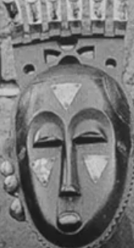

Learning objective:
● To explore the concept of identity and cultural diversity.
Activity 2: Creative Writing (group work)
As you watch clips 2 and 3, in pairs or in small groups, write a short paragraph to describe Africa, emphasizing its diversity and cultural richness.
Be prepared to share your answer with the class!
Success Criteria:
● Explain the terms ‘Identity’ and ‘Cultural Diversity’
● Explain the meaning of African identity.
● Describe how geography can influence cultural diversity.
● Apply understanding of African identity in a piece of writing.
Clip 2: The geography of Africa (BBC Bitesize)
https://www.bbc.co.uk/bitesize/topics/zsw4kty/articles/z2k6p4j#zm8tn9q
Clip 3: How diverse is Africa?
https://www.youtube.com/watch?v=YUQQm2f1rDk
Activity 3: Independent Writing Task
Using colour, symbolism and cultural motifs, create an artwork, or a poem, that reflects your interpretation of African identity incorporating elements from activity 2.
You may be asked to share your work with the class.
Cross-Curricular links: Literature /History / Geography / PSHE / Art
Reflection:
How has your understanding of African Identity and cultural diversity deepened through these activities?
Keywords:
Identity / Cultural Diversity / African Identity / Cultural Awareness

Slide 7



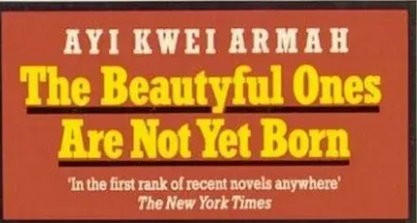



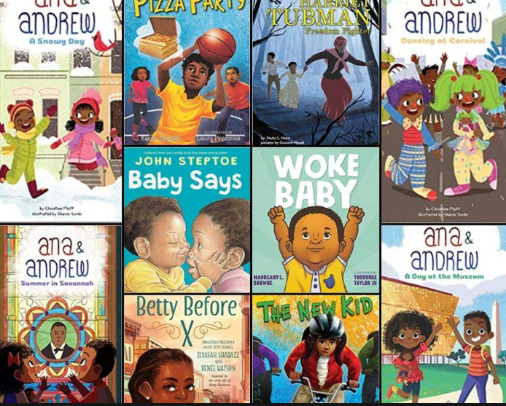
Culture Trip: African Literature
Can you add to the list?

